Slide 1
Miniforge installation (Anaconda Alternative)
Jewook Park 2025 0820-

Slide 2
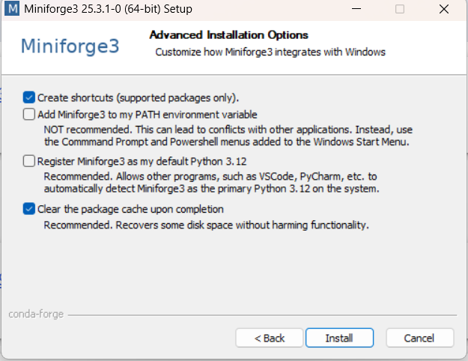
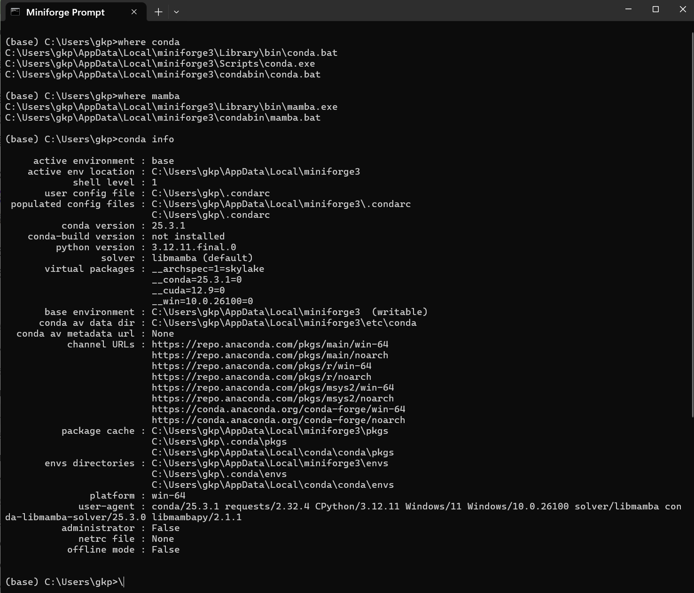

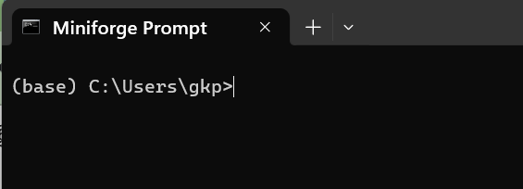
GPT5 support
Download miniforge
  https://conda-forge.org/download/?utm_source=chatgpt.com
Default install location
  C:\Users\gkp\AppData\Local\miniforge3
  Run miniforge prompt
Check condition
  where conda
  where mamba
  conda info

Slide 3
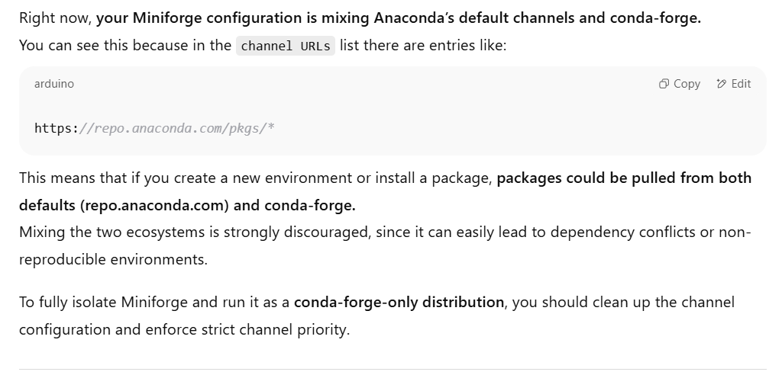
Conda condition
➔
conda config --env --remove channels defaults
conda config --env --add channels conda-forge
conda config --env --set channel_priority strict
conda config --env --remove-key default_channels
conda config --env --add default_channels https://conda.anaconda.org/conda-forge

Slide 4
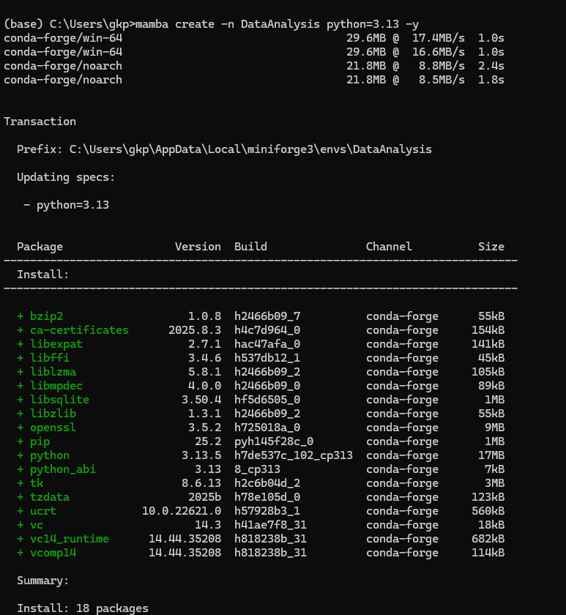
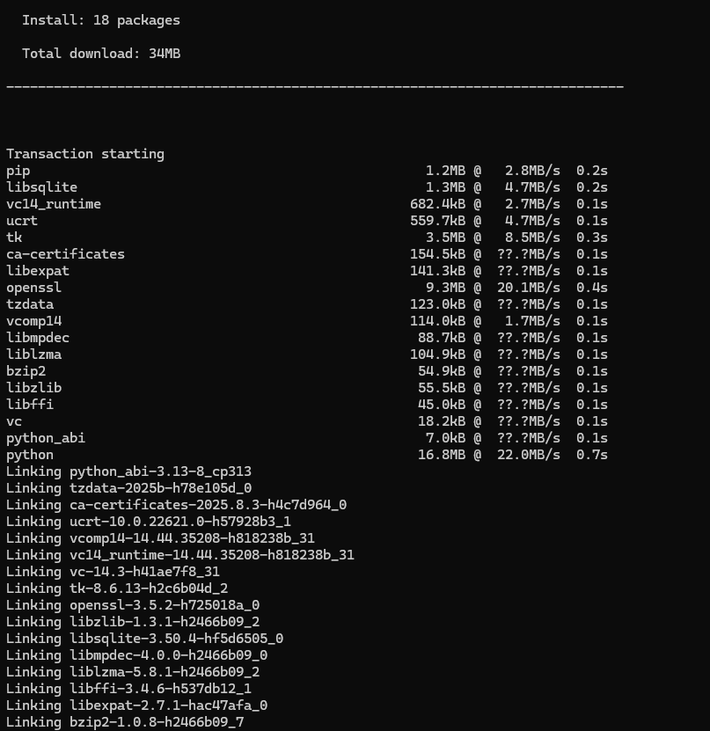
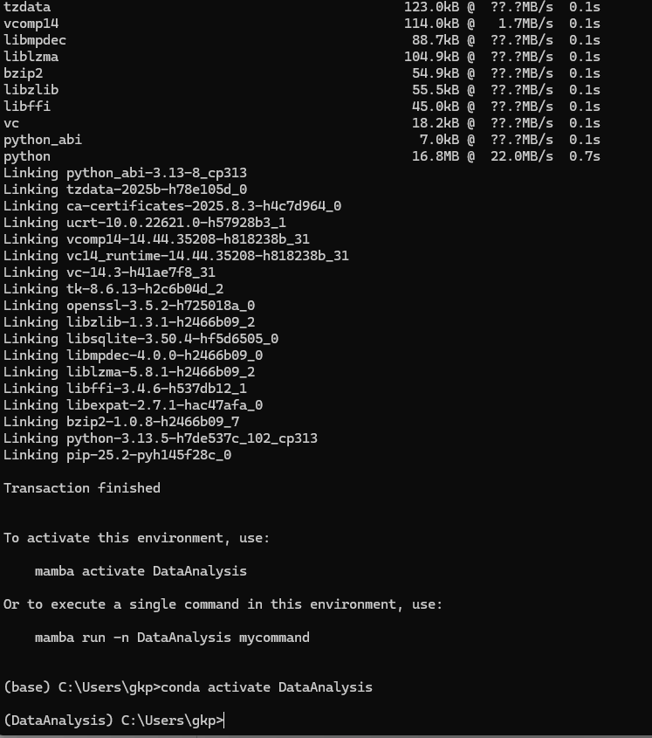
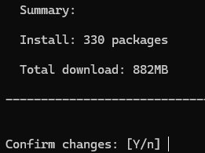
Env for DataAnalysis create
mamba create -n DataAnalysis python=3.13 -y
conda activate DataAnalysis
“environment.yml” file is ready. (environment .yml → save to targe folder)
  (DataAnalysis) C:\Users\gkp>mamba env update -n DataAnalysis -f "C:\Users\gkp\OneDrive - Oak Ridge National Laboratory\Research\Data Analysis (python)\Miniforge(mamba) Installation\environment.yml"
  conda-forge/noarch Using cache
  conda-forge/win-64 Using cache
  Transaction
  Prefix: C:\Users\gkp\AppData\Local\miniforge3\envs\DataAnalysis
  Updating specs:
  -

Slide 5
environment .yml
name: DataAnalysis
channels:
- conda-forge
- nodefaults
dependencies:
- python=3.13
- jupyterlab
- ipykernel
- ipywidgets
# numerical / stats
- numpy
- pandas
- scipy
- statsmodels
- scikit-learn
- numba
# image analysis
- scikit-image
- opencv
- pillow
- imageio
# visualization (2D + interactive 3D)
- matplotlib
- plotly
- pyvista
- ipyvtklink
# mayavi stack (VTK/Qt/OpenGL)
- mayavi
- vtk
- pyqt
- pyopengl

Slide 6
Jupyter Lab
Kernal
python -m ipykernel install --user --name DataAnalysis --display-name "Python (DataAnalysis)“
Run
  jupyter lab

